Slide 1
Progressive Web Apps (PWAs)
Module 19

Slide 2
What is a PWA?

Slide 3
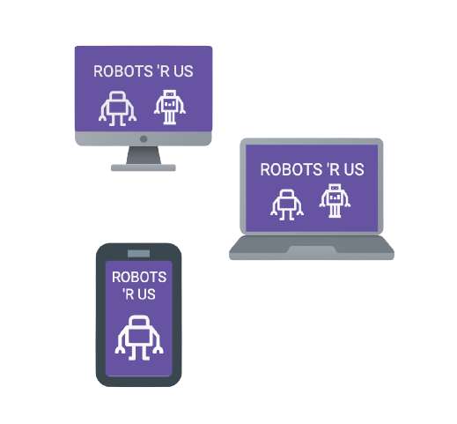
PWA Is a Design Pattern
A Progressive Web App (PWA) is a design pattern that uses web technologies to build a fast, flexible web application that will perform like a native app on any device.

Slide 4
Are PWAs dependent on specific technology?

Slide 5
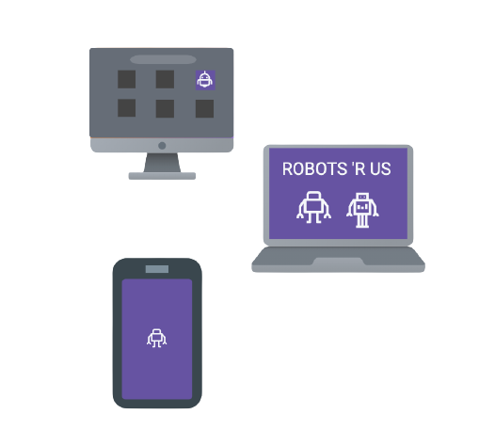
PWAs Are Focused on Optimizations, Not Specific Tech
PWAs do not rely on a single, specific technology. Instead, they use a variety of tools to build and optimize web applications to take advantage of features already available on the user’s device and browser.
(Installable)
@TODO ADD GRAPHIC TO LLUSTRATE EXPLANATION
(WORKS OFFLINE)
(Splash Screen)

Slide 6

A PWA Is an Optimized Web App
A PWA is simply a web app built using standard technologies that works in a browser and is optimized to improve performance and user experience.
(Web Application)
(Web application optimized
using PWA design pattern)

Slide 7
What makes an app a PWA?

Slide 8
PWA Design Pattern Optimizations
PWA are optimized to be fast.
PWAs are optimized to work offline.
PWAs are installable by users directly on their devices.
PWAs are secure.

Slide 9
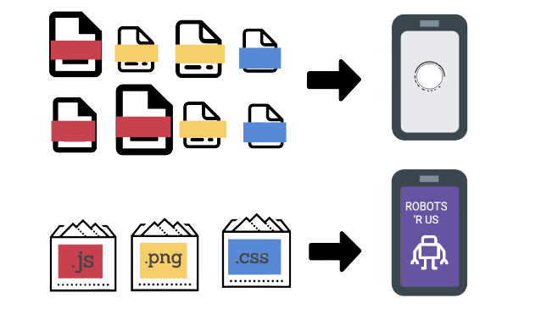
PWAs Are Fast
To give the user the look and feel of a native app, assets are bundled. This gives users a faster, more performant app.

Slide 10
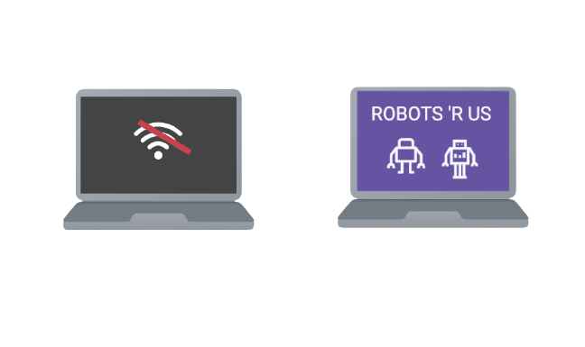
PWAs Work Offline
A PWA also uses a service worker, which allows a user to access visited pages even if the app is offline.
(Web application)
(Progressive Web Application)

Slide 11
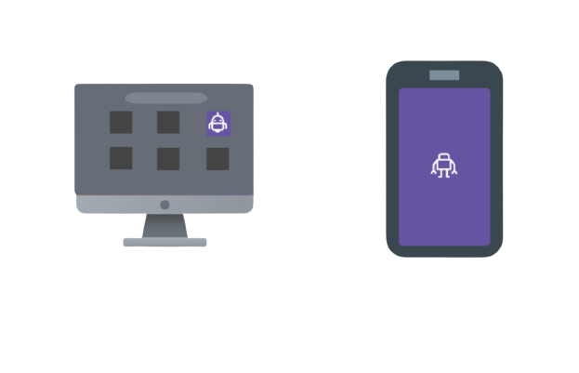
PWAs Are Installable
A PWA uses a special set of instructions for the browser called a manifest.json, which adds a splash screen and makes the app installable directly on the user’s device.
@TODO ADD GRAPHIC
TO ILLUSTRATE
EXPLANATION
(Installable)
(Splash Screen)

Slide 12

PWAs Are Secure
A PWA works on a secure connection to help keep users and their data safe.
(HTTPS stands for hypertext transfer protocol secure)

Slide 13
What are the key benefits of PWAs?

Slide 14
Key Benefits of PWAs
PWA is an adaptable design pattern with principles that can be applied to any web application.
PWAs focus on optimizing web applications to be faster and more performant.
PWAs enhance web applications by taking advantage of the user’s browser capability to provide a native app experience on any device.
PWAs are cost effective! With PWAs, there is no need to build a separate mobile and desktop application. A single app works for all devices.
PWAs can be directly installed by the user. There is no need for costly app stores!
PWAs deliver the speed and features that users expect in a modern app.

Slide 15
Mini-Project

